Slide 1
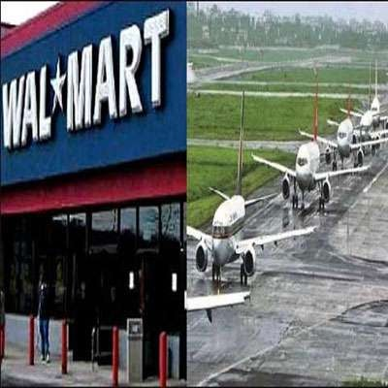

Foreign Direct Investment In India
Made By Akshay Gupta
160410116039

Slide 2

Meaning of FDI
FDI is direct investment into production in a country by a company located in another country, either by buying a company in the target country or by expanding operations of an existing business in that country.

Slide 3
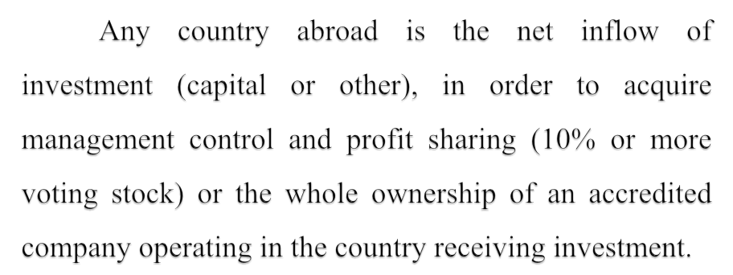

Slide 4
FDI offers an exclusive opportunity to enter into the international or global business, new markets and marketing channels, elusive access to new technology and expertise, expansion of company with new or more products or services, and cheaper production facilities.

Slide 5

India received FDI worth US $1.47 billion in july 2012 with
cumulative inflow for April 2012-13 Stood at $5.9billion.
The sector which attracted huge FDI inflows during the April 2012- 13 are service $1.65 million pharmaticals $428 million, construction
$421 million, metallurgical industries (US$ 334 million), power (US$ 237 million) and automobile (US$ 234 million)

Slide 6

 At least 10% shares of company need to quality as FDI.
 Mauritian has been the largest direct investor.
 New Delhi And Mumbai are two major cities where FDI inflows is heavily concentrated.
 Retailing is the single largest component of the services sector in terms of contribution of GDP.

Slide 7

Inflow of equipment and technology
Competitive advantages and innovation
Finance resource for expansive
Employment generation
Contribution to export growth
Improved consumer welfare through reduced cost, wider choice & improved quality.
Provide access to global markets for Indian producer.

Slide 8

 Crowing of local industry
 Conflict of laws
 Loss of control
 Effect on notional environment
 Effect on culture

Slide 9






















Services Sector
6%
4%
4%
Computer Software & hardware Telecommunications
3%
6%
Housing & real Estate
10%
Construction Activities
31%
Power
11%
Automobile Industry
Metallurgical Industries
12%
Petroleum & Natural Gas
13%
Chemicals

Slide 10
RIL-BP deal
BP-Plc. is making one of the biggest foreign direct investments (FDI) in India, with a $7.2 billion tie-up with Reliance Industries to explore for deep-water oil and gas.
A partnership with BP will give RIL access to the UK's major's expertise in finding and pumping oil and gas from deep below seabed. RIL needs such frontier technology to arrest the sharp fall in volumes from the Andhra offshore field, which has left the exploration regulator fuming and the government in a quandary over long queue of industries clamouring for gas.

Slide 11
For BP, the deal was an easy entry into India's exploration sector. With a strong domestic player such as RIL, BP will not be exposed fully to the risks of going solo in a geography not seen as highly prospective. But the long-term upside lies in India's growing market for gas, particularly the variety imported in ships (LNG, or liquefied natural gas).
The Indian companies informed BP that this partnership would be meaningful only if it came with access to BP's markets and oilfields. This was because the state-owned companies had enough cash of their own and were not looking at funding. Second, BP had no refining technology of its own and the Indian firms will anyway have to source it from elsewhere.

Slide 12
The End

